Slide 1
Kubernetes Basics

Slide 2

Everyone’s container journey starts with one container….

Slide 3
At first the growth is easy to handle….

Slide 4
But soon you have many applications, many instances…

Slide 5
And that is why there is container orchestration

Slide 6
What is container orchestration?
Management of the deployment, placement, and lifecycle of workload containers
Cluster management
Federates multiple hosts into one target
Scheduling
Distributes containers across nodes
Service discovery
Knows where the containers are located
Distributes client requests across the containers
Replication
Ensures the right number of nodes and containers
Health management
Replaces unhealthy containers and nodes
Container Orchestrator
Manager
Scheduler
Discovery DB
Image repository
Replicator
Node
Node
Node
Daemon
Daemon
Daemon
Containers
Containers
Containers

Slide 7
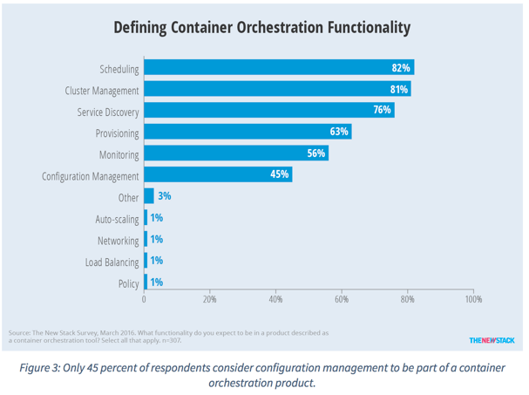
Container orchestration responsibilities
Container orchestration
Scheduling
Cluster management
Service discovery
Related functionality
Provisioning
Monitoring
Configuration management

Slide 8
Container ecosystem
Application workflow
7
Container orchestration
6
Kubernetes, Docker Swarm,
Apache Mesos
Container scheduling
5
Container engine
4
Docker
Operating system
Ubuntu, RedHat,
CoreOS
3
Virtual infrastructure
2
VMWare, AWS
Physical infrastructure
1
Notes:
Several layers are needed to support the container ecosystem. Each layer builds upon the previous one to enable a complete application workflow from code commit to deployment.
Layer 1 is the physical infrastructure, the actual hardware where resources are deployed. This hardware might be owned, or leased through the cloud.
Layer 2 is the virtualization of that infrastructure, through the use of software like VMWare, or Amazon Web Services.
Layer 3 is the operating system. You can choose one or more operating systems to deploy containers, including Ubuntu, RedHat, CoreOS, and others.
Layer 4 is the container engine that manages running containers on the operating system, and might include container image management, or just raw container services. Docker is a container engine.
Layer 5 is for container scheduling. This layer manages the lifecycle of containers, including starting, stopping, and destroying them as required. This function is covered by some container orchestrators, like Kubernetes.
Layer 6 is for container orchestration. This layer enforces the defined requirements for a set of containers, does scheduling to enforce those requirements, and offers services for monitoring container health and logging statistics. Kubernetes has all these features.
Layer 7 is the application workflow. It supports the creation of container images from source code, identifies and configures service dependencies, routing, and service provisioning by using the container orchestration layer.

Slide 9
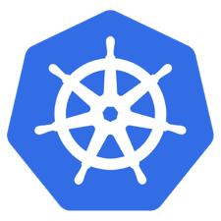
What is Kubernetes?
Container orchestrator
Runs and manages containers
Unified API for deploying web applications, batch jobs, and databases
Maintains and tracks the global view of the cluster
Supports multiple cloud and bare-metal environments
Manage applications, not machines
Rolling updates, canary deploys, and blue-green deployments
Designed for extensibility
Rich ecosystem of plug-ins for scheduling, storage, and networking
Open source project managed by the Linux Foundation
Inspired and informed by Google's experiences and internal systems
100% open source, written in Go
Notes:
Kubernetes is an open-source container orchestrator that was developed by Google to manage applications that run in a container environment. So, why use containers? In short, containers are small, agile, and portable, so they can help you deploy and manage applications quickly, and scale up or down in response to demand. In the container deployment model, applications are not tied to specific host computers, so they can be distributed across available resources in a more efficient way. This kind of environment is ideal for deploying microservices.
Microservices is an architectural style that decomposes an application into a set of loosely-coupled services, which can be fine-grained and lightweight. This style promotes modularity, parallel development, continuous delivery, and numerous other benefits.
But, having numerous microservices that run on containers can become challenging to manage, so that’s where Kubernetes comes in.
Kubernetes automates the deployment, scaling, and operation of application containers. and provides tools and APIs to manage production workloads on containers.
It also supports multiple cloud and bare-metal environments, and was designed for extensibility, so there is a rich ecosystem of plug-ins that extend its functionality. There are plug-ins for scheduling, storage, networking, and so on.

Slide 10
Kubernetes strengths
Clear governance model
Managed by the Linux Foundation.
Google is driving the product features and roadmap, while allowing the rest of the ecosystem to participate.
Growing and vibrant ecosystem
IBM, Huawei, Intel, and Red Hat are among the companies making prominent contributions to the project.
Avoid dependency and vendor lock-in
Active community participation and ecosystem support.
Support for a wide range of deployment options
Customers can choose between bare metal, virtualization, private, public, and hybrid cloud deployments
Wide range of delivery models across on-premises and cloud-based services.
Design is more operations-centric
First choice of DevOps teams.
Notes:
Kubernetes has a clear governance model managed by the Linux Foundation. Google is actively driving the product features and roadmap, while allowing the rest of the ecosystem to participate.
A growing and vibrant Kubernetes ecosystem provides confidence to enterprises about its long-term viability. IBM, Huawei, Intel, and Red Hat are some of the companies making prominent contributions to the project.
The commercial viability of Kubernetes makes it an interesting choice for vendors. We expect to see new offerings announced over the next several months.
Despite the expected growth in commercial distributions, Kubernetes avoids dependency and vendor lock-in through active community participation and ecosystem support.
Kubernetes supports a wide range of deployment options. Customers can choose between bare metal, virtualization, private, public, and hybrid cloud deployments. It enjoys a wide range of delivery models across on-premises and cloud-based services.
The design of Kubernetes is more operations-centric than developer-orientated, which makes it the first choice of DevOps teams.

Slide 11
Kubernetes cluster architecture
Kubernetes cluster
Master node
scheduler
.yaml
kubectl
Kubernetes API
controller
Worker node
Worker node
kubelet
kubelet
Docker
Docker
pod
pod
pod
pod
10.0.0.1
10.0.0.2
10.0.0.3
10.0.0.4
Notes:
The Kubernetes architecture is based around this concept of a cluster. A cluster consists of one or more virtual machines that are called worker nodes. Each worker node represents a compute host where you can deploy, run, and manage containerized applications. Worker nodes are managed by a Kubernetes master node that controls and monitors all Kubernetes resources in the cluster. A scheduler service decides where to deploy the app, taking into account the deployment requirements and available capacity in the cluster. For simplicity, this diagram only shows two worker nodes, but in a production environment, you want to have at least three worker nodes.
The nodes communicate with the master by using the Kubernetes API, which the master exposes. You can use the command-line interface, kubectl, to interact with the master.
Each worker node runs an agent, called a kubelet, which manages the node, and communicates with the master. Each worker also has tools for managing containers, such as Docker.
To deploy an application on Kubernetes, you create a deployment configuration (in the form of a .yaml file) to tell Kubernetes how to manage instances of the application on the cluster. This script is where you specify your container configuration and other Kubernetes resources that are required to run the application, such as persistent storage, services, and annotations. When you run a deployment, the Kubernetes master deploys the specified number of containers, taking into account the capacity that is available on the worker nodes of the cluster. Kubernetes creates and configures other resources as specified in the deployment script. You can use a deployment to define update strategies for your app, which can define what to do during a rolling update. When you perform a rolling update, the deployment checks whether it’s working, and stops the rollout if failures are detected.
Kubernetes creates a pod to host the application instance. A pod can include one or more application containers and some shared resources, such as storage, networking information, and so on.
The containers in a pod share an IP Address and port space, are always co-located and co-scheduled, and run in a shared context on the same node. You also specify the number of pod replicas to run in the deployment configuration. Pods represent the smallest deployable units in a Kubernetes cluster and are used to group containers that must be treated as a single unit. In most cases, a container is deployed to its own pod. However, an app might require a container and other helper containers to be deployed into one pod so that those containers can be addressed by using the same private IP address.
A Kubernetes deployment controller monitors the application instances. If a node that is hosting an instance stops running, or is deleted, Kubernetes creates another pod on an available node to run the instance.

Slide 12
Master node components
Make scheduling decisions for the cluster, and respond to cluster events, like a node failure
Can run on any node in the cluster, but typically all master components run on the same virtual machine (vm), and do not run any container apps on that vm
Master node
scheduler
kube-controller-manager
Node controller
DNS
Replication controller
Endpoints controller
Kubernetes API
etcd
Service account &
token controller
Notes:
Several master components provide control functions for the Kubernetes cluster, such as scheduling, monitoring, and responding to cluster events, like a node failure. You can run master components on any node in the cluster, but typically they all run on the same virtual machine and do not co-reside with any container applications on that vm.
Kube-apiserver is the component that exposes the Kubernetes API. This is the interface for communicating with the master, and it is designed to scale horizontally, by deploying more instances.
Etcd is the persistent store that Kubernetes uses to store cluster data. It is important to have a backup plan for this data if you want to be able to restore the cluster.
Kube-controller-manager runs the controllers that handle various tasks in the cluster, and there are several of these controllers, as follows:
The node controller monitors nodes and responds if a node goes down.
The replication controller maintains the desired number of pods (as defined in the deployment) for the cluster.
The endpoints controller connects services to pods.
And, the service account & token controller creates the required accounts and access tokens for new namespaces.
The kube-scheduler component selects the node that a pod will run on.
Kubernetes has a built-in DNS server that manages DNS records for Kubernetes services in the cluster. It configures the kubelets to tell individual containers to use the DNS service IP address to resolve DNS names.

Slide 13
Kubernetes terminology: Master node components
Etcd
A highly-available key value store
Stores all cluster data
API Server
Exposes API for managing Kubernetes
Used by kubectrl CLI
Scheduler
Selects the worker node for each pods runs
Controller manager
Daemon that runs controllers (background threads that handle routine tasks in the cluster)
Node Controller – Responsible for noticing and responding when nodes go down
Endpoints Controller – Populates the Endpoints object (joins services and pods)
Service Account and Token Controllers – Create default accounts and API access tokens for new namespaces

Slide 14
Worker node: Components
Provide the Kubernetes runtime environment; run on every node
Maintain running pods
Worker node
kubelet
kube-proxy
Docker
pod
pod
10.0.0.3
10.0.0.3
Notes:
The components that run on each worker node in the cluster provide the Kubernetes runtime environment and maintain running pods.
The kubelet agent has several functions, as follows:
Mounts a pod’s required volumes.
Downloads a pod’s secrets.
Runs a pod’s containers in Docker.
Runs any requested container liveness probes.
Reports the status of pods and the node back to the cluster.
The kube-proxy forwards connections according to network rules on the host.
Containers run by way of Docker.

Slide 15
Kubernetes terminology: Workloads
Kubernetes components
Worker node 1
Master node
pod
pod
App A
App B
Worker node 2
App A
client
App A
service
pod
pod
App B
App A
App B
client
App B
service
Worker node 3
pod
pod
App A
App B
Notes:
Container is the packaging of an application
Pod is a unit of deployment
Service is the fixed endpoint for one or more pods

Slide 16
Kubernetes terminology: Workloads
Container
Unit of packaging
Pod
Smallest deployment unit in Kubernetes
Collection of containers that run on a worker node
Has its own IP address
Shares a PID namespace, network, and hostname
Service
Collection of pods exposed as an endpoint
Types:
ClusterIP
NodePort
LoadBalancer
ExternalName
Notes:
There are four services types:
ClusterIP exposes the service on a cluster-internal IP
NodePort exposes the service on each node’s IP at a static port
LoadBalancer exposes the service externally using a cloud provider’s load balancer
ExternalName maps the service to an external name, such as foo.bar.example.com
A Service is an abstraction that defines a set of pods and a policy by which to access them. A service targets a set of pods, typically by using a label selector. The service can be exposed in a number of ways:
It can expose the cluster internal IP address.
It can expose the service on each node IP address at a static port.
It can expose the service externally by using a cloud provider’s load balancer.
Or, it can map to an external name, such as myservice.example.com.
For Kubernetes-native applications, Kubernetes offers a simple Endpoints API that is updated whenever the set of pods in a service changes. For non-native applications, Kubernetes offers a virtual-IP-based bridge to services, which redirects to the back-end pods.

Slide 17
Kubernetes terminology: Deployments and replica sets
Deployments
Describe the “desired state”
Provide declarative updates for pods and replica sets
Replica sets
Use pod templates to define a set of pod replicas
Ensure that the specified number of pod replicas are running
Can be used directly, but are typically used with deployments to orchestrate the pod lifecycle
Cluster
Service
Worker node
Deployment
Replica set
Pod 1
Pod 2
Notes:
A deployment object is a Kubernetes resource where you specify your containers and other Kubernetes resources that are required to run your application. Basically, you describe the “desired state” in the deployment, and a deployment controller rolls out the changes to create this state. You can also use deployments to create replica sets.
A replica set uses pod templates to define a set of pod replicas.
A pod template describes what a pod should contain.
The replica set ensures that the specified number of pod replicas are running at any given time.
Replica sets can be used directly, but are typically used with deployments to orchestrate the pod lifecycle.
Deployments own and manage their own replica sets, and provide other useful features, so you don’t have to manage replica sets directly, unless you require custom update orchestration, or don’t require updates at all.

Slide 18
Kubernetes terminology: Deployments
Set of pods deployed together such as an application.
Declarative: Revising a deployment creates a ReplicaSet describing the desired state
Rollout: Deployment controller changes the actual state to the desired state at a controlled rate
Rollback: Each deployment revision can be rolled back
Scale and autoscale: A deployment can be scaled
.
Deployment
ReplicaSet 1
ReplicaSet 2
rolling update
pod
pod
pod
svcA
svcA
svcB
Notes:
https://kubernetes.io/docs/concepts/workloads/controllers/deployment/
https://kubernetes.io/docs/concepts/workloads/controllers/replicaset/
https://kubernetes.io/docs/user-guide/kubectl/v1.6/#rollout
https://kubernetes.io/docs/user-guide/kubectl/v1.6/#rolling-update
https://kubernetes.io/docs/concepts/cluster-administration/manage-deployment/#canary-deployments
Blue-green deployment isn’t built-in to Kubernetes (as of July 2017). Some examples others have built:
https://techbeacon.com/one-year-using-kubernetes-production-lessons-learned
http://www.devoperandi.com/kubernetes-deployment-resource-bluegreen-deploys-for-everyone/

Slide 19
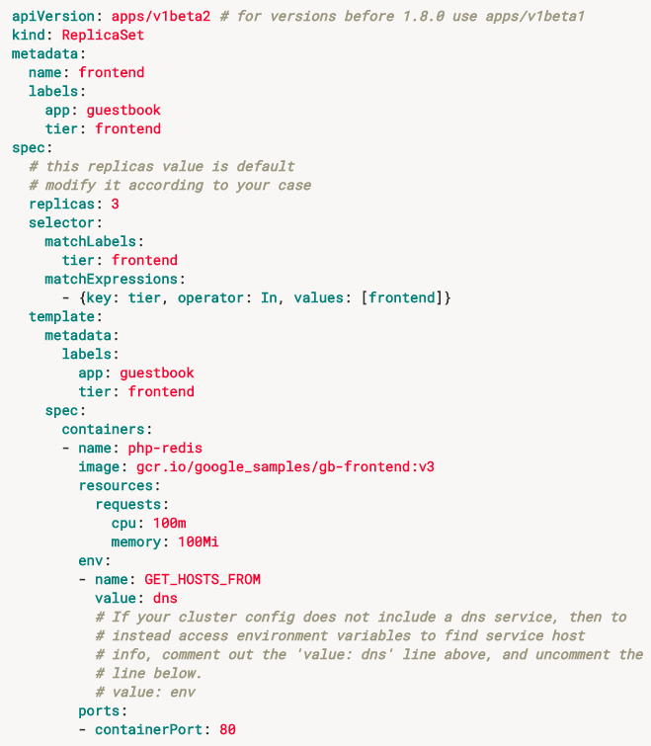
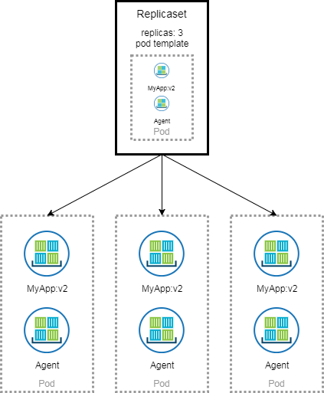
Kubernetes terminology: Replica sets
Scale and provide resiliency.
Replicasets run one-to-many instances of the desired pod.
When possible the replica pod should be stateless or near-stateless.
Ensures that a specific number of pod replicas are running.
Notes:
Reasons for replica sets: Redundancy, scale, sharding
Building blocks for used to describe common app deployment patterns and are the underpinnings for self-healing
K8s constantly reconciles the current state (number of healthy replicas)
You can quarantine a pod in a replicaset by modifying one of the labels
Should be stateless or near stateless
Kubectl get pods <pod name> -o yaml -> help you find the replicaset from the pod
Kubectl get pods –l <key value pairs of labels> comma separate for AND
Can autoscale using a min and max numbers of pods and setting for instance a cpu threshold

Slide 20
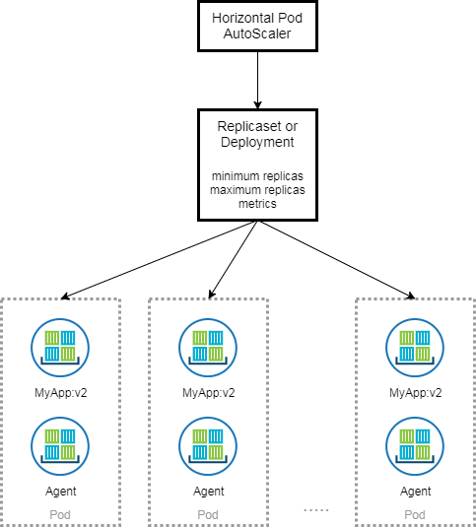
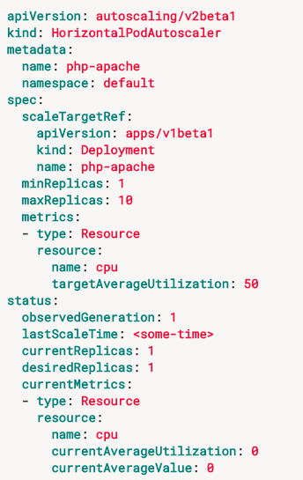
Kubernetes terminology: Autoscaling
Horizontal Pod Auto-scaling (HPA)
Able to scale the number of running pods in a replicaset based upon resource (or application custom) metrics.
Notes:
Horizontal Scaling (increasing the instances of an application ie the number of pods in a replicaset
With an app such as nginx you may want to scale based upon CPU usage
For an in memory cache app, you may want to scale based upon memory consumption.
You may want to use custom app metrics.
Horizontal Pod Autoscaling HPA
Heapster keeps track of the metrics
Vertical scaling involves increasing the resources required for a particular pod (not yet fully implemented but in plan)
Cluster Scaling (number of machines in the ICP cluster)

Slide 21
Kubernetes terminology: Naming
Name
Each resource object by type has a unique name
Namespace
Resource isolation: Each namespace is a virtual cluster within the physical cluster
Resource objects are scoped within namespaces
Low-level resources are not in namespaces: nodes, persistent volumes, and namespaces themselves
Names of resources need to be unique within a namespace, but not across namespaces
Resource quotas: Namespaces can divide cluster resources
Initial namespaces
default – The default namespace for objects with no other namespace
kube-system – The namespace for objects created by the Kubernetes system
Notes:
In Kubernetes, each resource object has a unique name and UID. The name can be client-specified. The UID is assigned by Kubernetes.
Resource objects are scoped within namespaces. Each namespace is a virtual cluster, backed by a physical cluster. Kubernetes supports multiple namespaces. Resource names must be unique within a namespace, but not across all namespaces.
Kubernetes provides two initial namespaces:
default: is the default namespace for objects with no other namespace, and
kube-system: is the namespace for Kubernetes-generated objects.
In an environment with a small number of users, you don’t really need to use namespaces. However, if you have many users spread out over multiple teams, you might want to use namespaces.
You can use namespaces to divide cluster resources according to use, and limit resource consumption by using resource quotas.
Alternately, you can use labels to distinguish resources in the same namespace. Labels are covered on the next slide.
Not all Kubernetes objects are in a namespace.
Low-level resources, such as nodes, persistent volumes, and namespaces themselves are not in a namespace.

Slide 22
Kubernetes configuring Containers and Resources
Label
Metadata assigned to Kubernetes resources (pods, services, etc.)
Key-value pairs for identification
Critical to Kubernetes
Selector
An expression that matches labels to identify related resources
ConfigMap
Configuration values used by containers in a pod
Configuration is stored outside of the container image
Secrets
Sensitive information that containers read or consume
Encrypted in special volumes mounted automatically
Notes:
Labels
A label is another way of identifying an object within a namespace. You can use labels to map your own organizational structures onto objects. For example, you can label objects as “development,” “test,” “production,” “stable release,” “frontend,” “backend,” “customer A,” “customer B” – what ever makes sense for your organization. The label key must be unique for each object. There are also rules for syntax and character set that you can look up in the Kubernetes documentation.
Labels do not provide uniqueness (like a name or UID does), and it’s possible to have many objects with the same label.
Selectors
A selector can include one or more requirements, separated by commas. All requirements must be satisfied to fulfill the selector, so the comma acts as an AND operator.
An empty label selector (that is, one with zero requirements) selects every object in the collection.
A null label selector (which is only possible for optional selector fields) selects no objects.
Kubernetes supports two types of selectors: equality-based and set-based.
An equality-based selector filters by label keys and values. It accepts the operators = (equal to), and != (not equal to).
In the examples shown here, the first line selects all resources with key equal to ”environment” and value equal to ”production.” The second one selects all resources with key equal to ”tier” and value not matching ”frontend.”
A set-based selector filters keys according to a set of values. It accepts the operators: in, notin (one word), and exists. The first example here selects all resources with key equal to ”environment” and values equal to ”production” and ”qa.” The second example selects all resources with key equal to ”tier” and values other than ”frontend” and ”backend.” The third example selects all resources that have a label key of ”partition.” The fourth example selects all resources that do not have a label key of “partition.”
Label selectors must not overlap within a namespace, otherwise they will conflict with each other.
ConfigMap
ConfigMaps store configuration outside of the container image, thus making containers more usable.
Secrets
The Kubernetes secret object can be used to hold sensitive information, such as passwords, OAuth tokens, and ssh keys (instead of putting this information directly into a pod or an image). For example, if a pod needs to access a database, and the username and password that the pod should use is stored in a couple of local files. You can create a secret object that packages these files.
A pod must reference a secret to use it, and can either reference it as a file in a volume that is mounted on one or more containers in the pod, or the secret can be exposed as an environment variable, and the kubelet can use it when pulling images for the pod.
You can use the kubectl create secret command to create a secret, or create the secret object in a JSON or YAML file.
To retrieve a secret, you can use the kubectl get secret command, and then decode it as necessary.
Service accounts automatically create and attach secrets with API Credentials. Kubernetes automatically creates secrets that contain credentials for accessing the API, and it modifies your pods to use this type of secret.

Slide 23
Kubernetes management architecture
UI
Master node
Worker node 1
Worker node 2
API
Worker node 3
CLI
Worker node n
Registry
Etcd
API Server
Controller Manager Server
Scheduler

Slide 24
Kubectl commands
Support different approaches to working with Kubernetes objects:
Imperative commands on live objects.
Individual configuration files or directories of files.
Important: maintain a consistent approach when working with the same object; do not mix approaches.
Basic syntax:
<verb> <objecttype> [<subtype>] <instancename>
Where the <verb> is an action such as: create, run, expose, autoscale.
<objecttype> is the object type, such as a service.
Some objects have subtypes. For example, a service has ClusterIP, LoadBalancer, NodePort.
Use the -h flag to find the arguments and flags supported by a subtype
<instancename> specifies the name of the object
Notes:
The kubectl command-line interface can be used in different ways when working with Kubernetes objects. You can use imperative commands that operate directly on live objects in a cluster, or you can configure objects imperatively in a local file, or declaratively in directories of files. There are advantages and disadvantages to each method.
The simplest way to run tasks in a cluster is by using imperative commands, and this is typically what you would do with a development project. In a production environment, you might want to store object configuration files in a source control system, or operate on a directory of configuration files, and integrate with a review or change process.
Whatever you choose, it is important that you maintain a consistent approach when working with the same object, and do not mix approaches, or unexpected behavior can result.
The basic syntax of the command uses a verb, followed by the object type, a subtype if applicable, and the instance name. The example command here creates a service of subtype nodeport called myservice.
The tutorials in this course walk through many examples of how to use kubectl commands, and you can find more detailed information about kubectl in the Kubernetes documentation.

Slide 25
Kubectl command useful examples
Get the state of a cluster
$ kubectl cluster-info
Get all the nodes of a cluster
$ kubectl get nodes -o wide
Get info about the pods of a cluster
$ kubectl get pods -o wide
Get info about the replication controllers of a cluster
$ kubectl get rc -o wide
Get info about the services of a cluster
$ kubectl get services
Get full config info about a Service
$ kubectl get service NAME_OF_SERVICE -o json
Get the IP of a Pod
$ kubectl get pod NAME_OF_POD -template={{.status.podIP}}
Delete a Pod
$ kubectl delete pod NAME
Delete a Service
$ kubectl delete service NAME_OF_SERVICE

Slide 26
Resources
Kubernetes tutorial
https://kubernetes.io/docs/tutorials/kubernetes-basics/
Introduction to container orchestration
https://www.exoscale.ch/syslog/2016/07/26/container-orch/
TNS Research: The Present State of Container Orchestration
https://thenewstack.io/tns-research-present-state-container-orchestration/
Large-scale cluster management at Google with Borg
https://research.google.com/pubs/pub43438.html

